Slide 1
18-1 Hit and Hurt
5CM503 Virtual Environment Development
Dr Patrick Merritt

Slide 2
Contents
Hit and Hurt

Slide 3
Hit Boxes
So far..

Slide 4
Hit Boxes
If we need a hitbox we probably do something like this…

Slide 5
Hit Boxes
If we need a hitbox we probably do something like this…
This is fine for simple shapes.

Slide 6
Hit Boxes
And we can detect collisions…

Slide 7
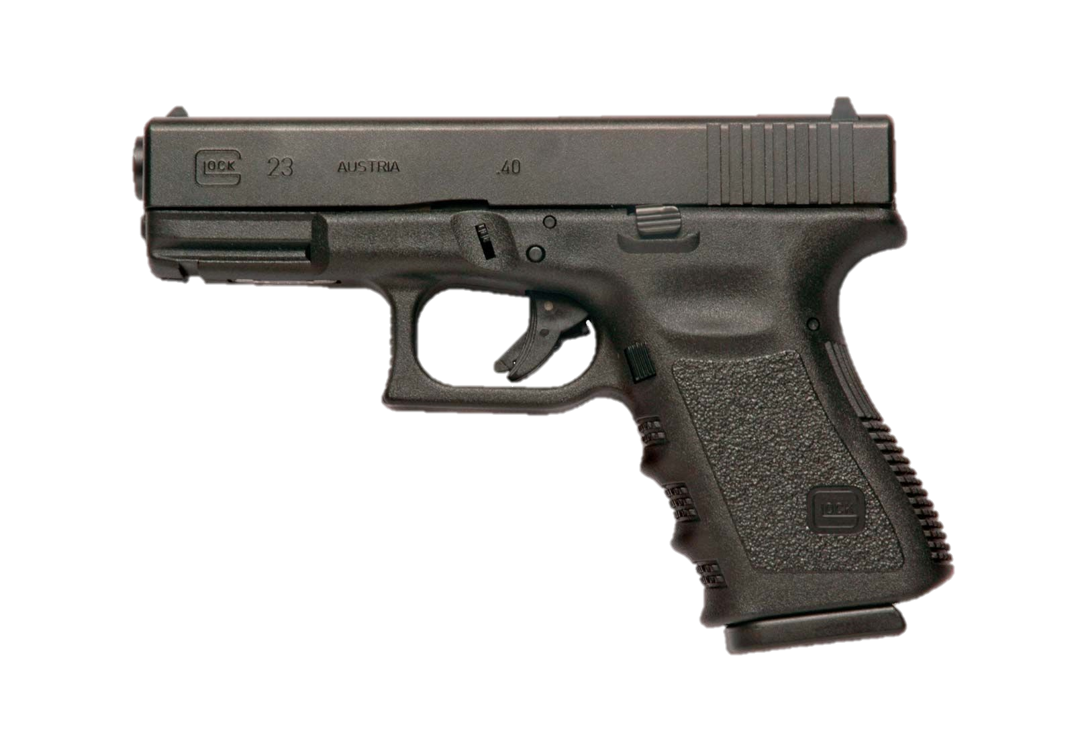

Guns
Pull trigger
Fire bullet
Hit target
Easy right?

Slide 8
Quick refresh time…
Remember this from GES?

Slide 9
Teleport locomotion
Work out how far the pawn should move in a turn.
Teleport to that new location.
Not influenced by physics.
No gravity / momentum unless you implement it.
No collision detection (can also screw up triggers and colliders)
A
B

Slide 10
Physics
Affected by physics…
A
B

Slide 11
Guns
So how does the bullet move?

Slide 12
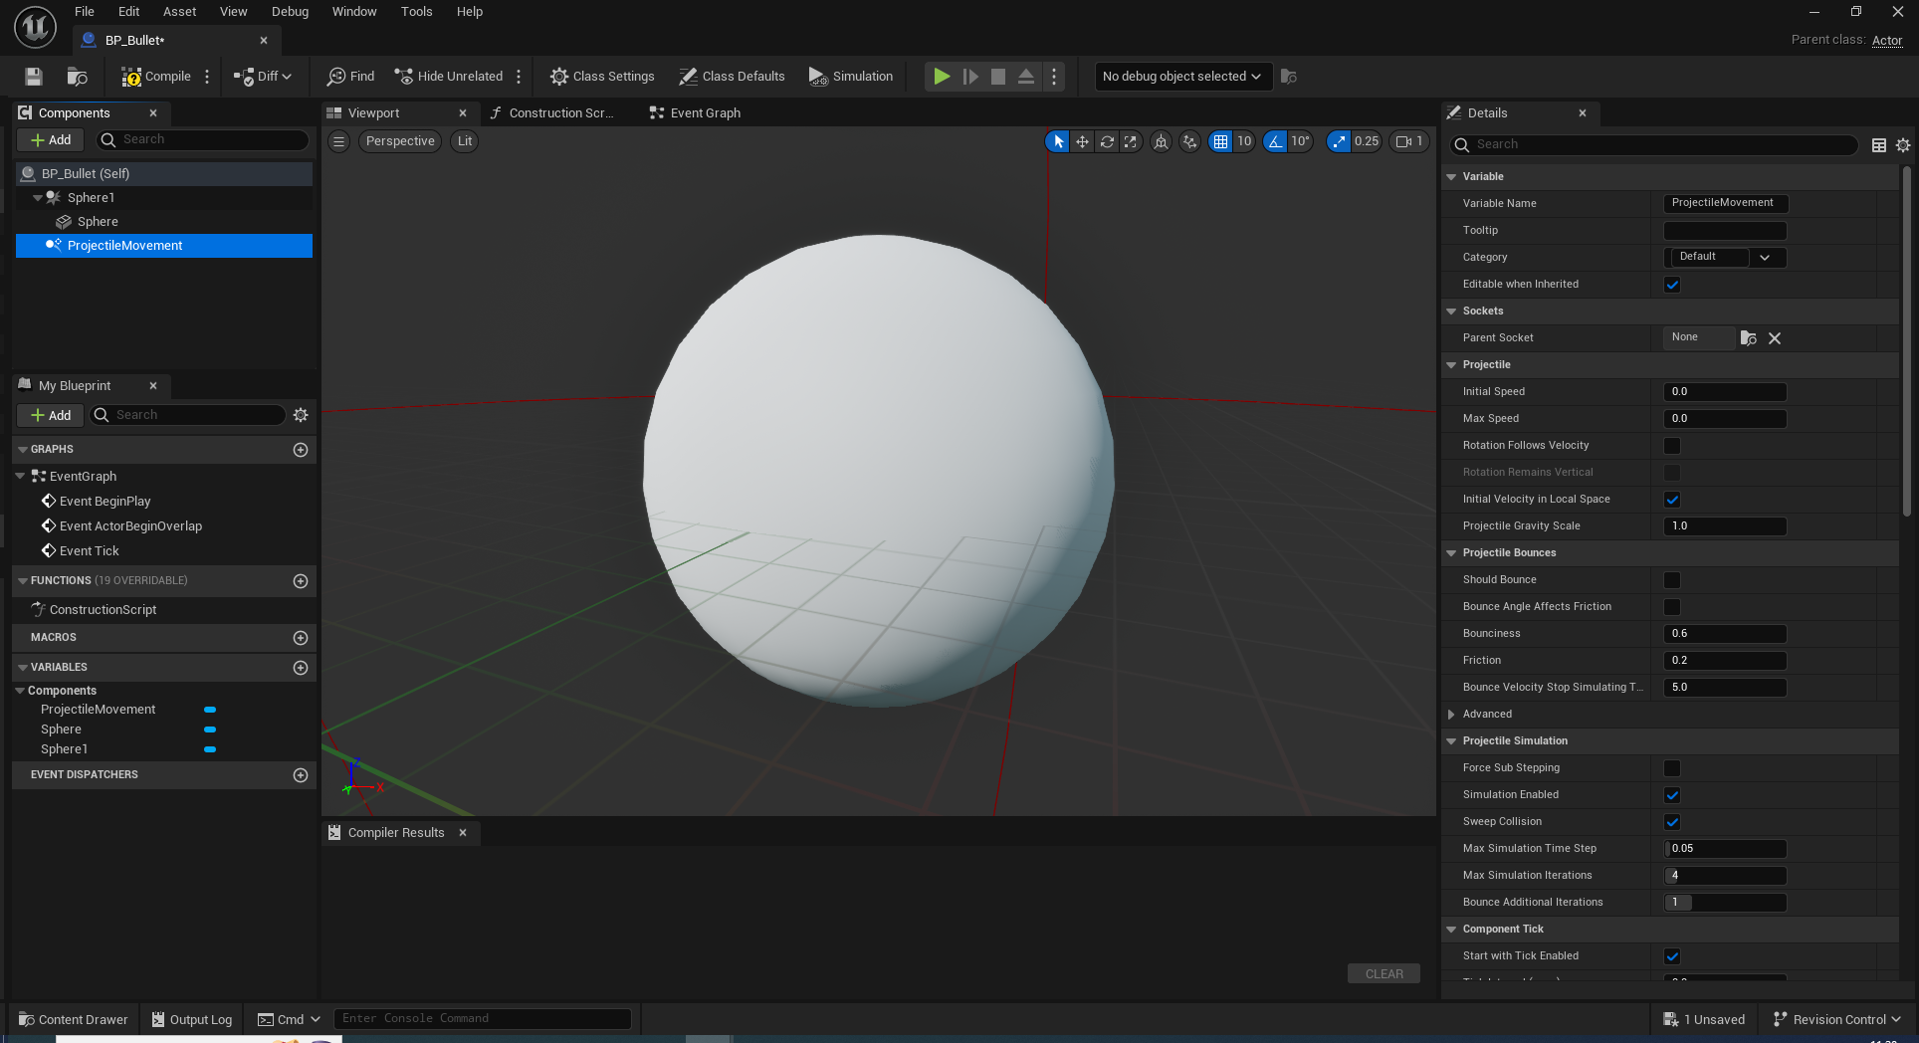
The projectile movement system only controls the movement…

Slide 13
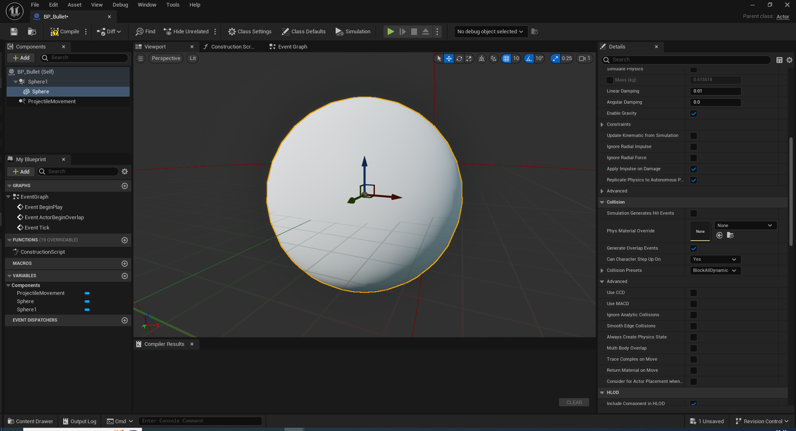
The collider controls it…

Slide 14
CCD Mode or Continuous Collision Detection

Slide 15
The difference…
Without CCD we don’t check between movements…
The number of samples is constant per movement…
So slow Speeds are fine…

Slide 16
The difference…
Fast Speeds however leave gaps…

Slide 17
The difference…
CCD traces the path of the object across the whole movement…
Removes the gaps.
But MUCH more expensive…

Slide 18
The difference…
CCD traces the path of the object across the whole movement…
Removes the gaps.
But MUCH more expensive…
Fast-moving objects benefit from this but it can cause bugs due to the speed involved at the end of the collision.

Slide 19
Extreme Speed
Sometimes, a weapon may have near-instant speed through an environment.
So fast that spawning a projectile is just pointless.
The object exists in the environment for 1 frame.
Thus, the bullet is created and destroyed in the same frame.
And objects moving that fast cause problems for the simulation.
So do we need to spawn them?

Slide 20
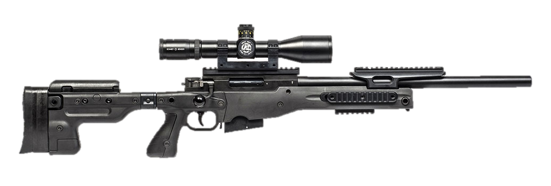
“Hit scan”
Fire a ray into the environment.
Return the hits and resolve them.
But, it makes the weapon feel like a laser beam.
Generally long-range weapons like snipers in arcade games.

Slide 21
Where do bullets come from?
They are actors…
But seriously where does the bullet come from?

Slide 22
Where do bullets come from?
Modern guns are usually skeletal meshes.
They have bones for animations allowing animations for bolts ect.

Slide 23
Where do bullets come from?
This means we can add sockets to bones.
Sockets are just vector points in space

Slide 24
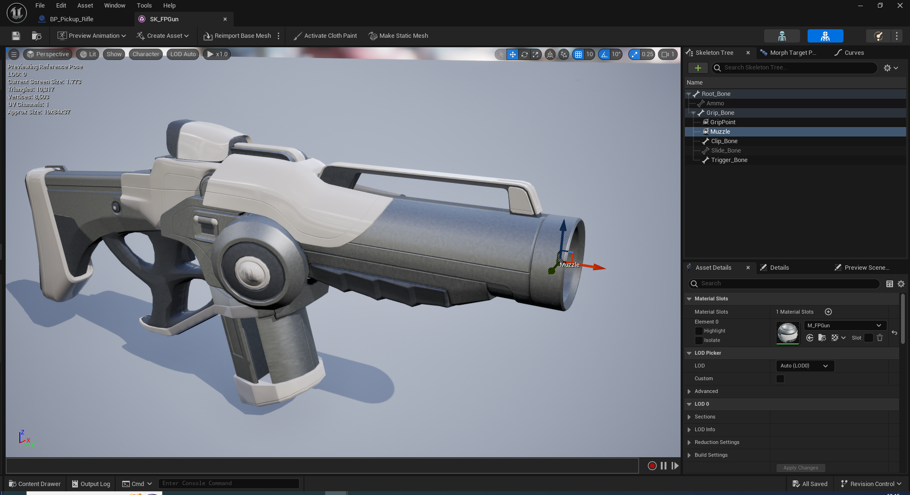
Sockets belong to meshes, NOT the gun objects.
Sockets are attached to bones, so as the bone moves the socket moves too

Slide 25
Where do bullets come from?
In most cases this is fine, however…

Slide 26
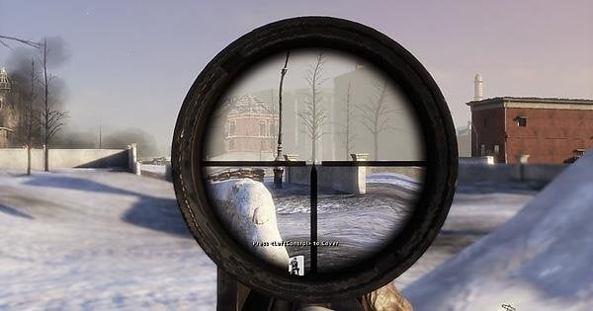
In ADS Mode…
Shots land here

Slide 27
In ADS Mode…
Not here…
Shots land here

Slide 28
Where do bullets come from?
So, this is problematic

Slide 29
Where do bullets come from?
The sight direction is adjusted to make the lines converge at a single point setting the range of the weapon.
Means the sight is accurate at that range but off at all others requiring compensation.

Slide 30
There is another slightly cheeky approach
Nothing says the bullet has to come from the barrel…
So, if you spawn it from the sight point…
Perfect accuracy!

Slide 31
Hurt boxes
Sometimes, however, you need to get up close and personal…

Slide 32
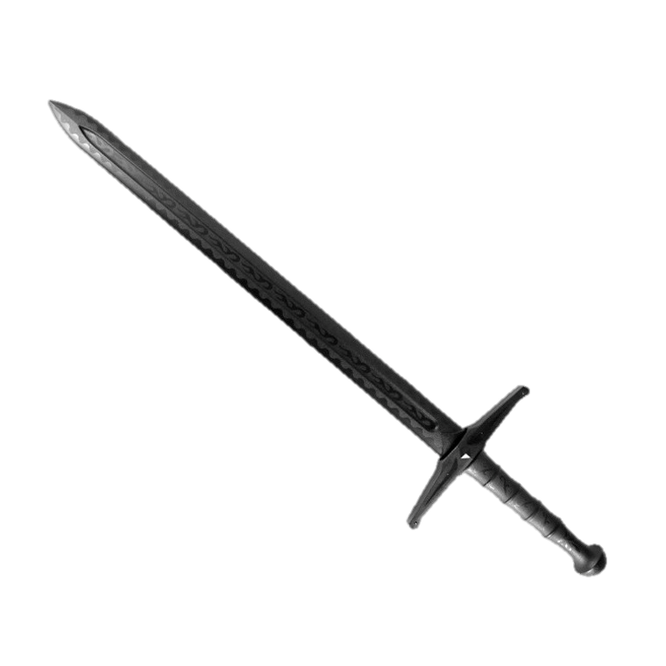
Jeremy has a sword!
I may have made a terrible mistake…

Slide 33
Jeremy has a sword!
You probably have made a combat model something like this…
Press button

Slide 34
Jeremy has a sword!
You probably have made a combat model something like this…
Press button…

Slide 35
Jeremy has a sword!
You probably have made a combat model something like this…
Press button…
Deal damage to everything in front…

Slide 36
This is fine in some situations…
Knife kills in cod?
Do we care if we exactly hit? Or is good enough good enough?
Sometimes, missing matters…

Slide 37
Jeremy has a sword!
Sometimes we don’t want to deal damage till the weapon actually hits…

Slide 38
Jeremy has a sword!
Sometimes we don’t want to deal damage till the weapon actually hits…
This is fine, we add a hitbox to the weapon.
Also affectionally known as a hurt box.

Slide 39
Jeremy has a sword!
Sometimes we don’t want to deal damage till the weapon actually hits…
This is fine, we add a hitbox to the weapon.
Also affectionally known as a hurt box.
But this adds another problem…

Slide 40
Jeremy has a sword!
Jeremy puts the sword away and goes to say hello to his good friend, not evil Jeremy

Slide 41
Jeremy has a sword!
Jeremy puts the sword away and goes to say hello to his good friend, not evil Jeremy

Slide 42
Jeremy has a sword!
Uh oh…

Slide 43
This is a problem
Melee weapons are not always on…
We could write a state machine to track when we are attacking and when not.
But this doesn’t wholly fix the problem…

Slide 44
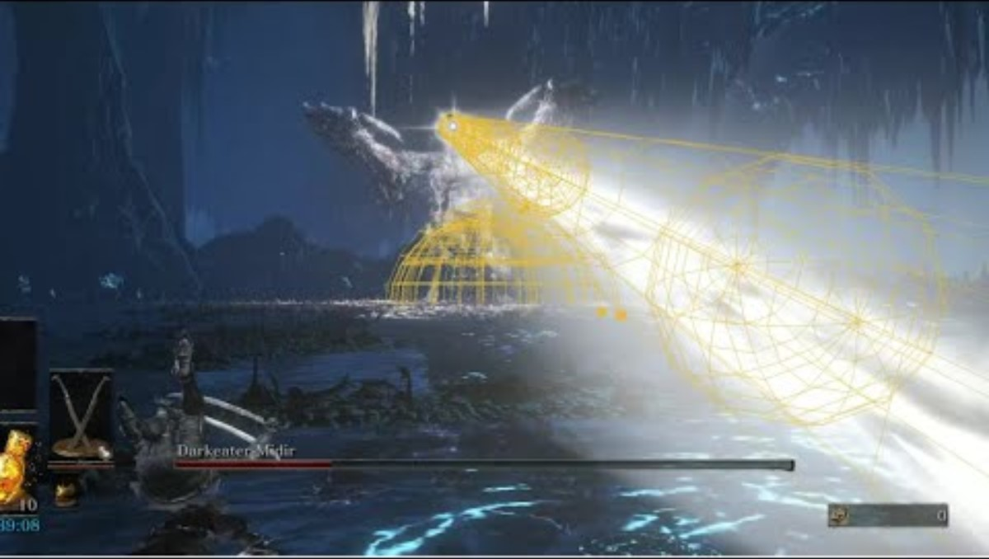

Slide 45
Animation Notify States
Animation Notify States, allow the program to generate events when parts of an animation play.
For example you can raise a notify event when the feet hit the floor in a run animation.
We can also raise these events to notify the code when an animation is actively doing damage and when not.
https://dev.epicgames.com/documentation/en-us/unreal-engine/animation-notifications-notifies?application_version=4.27

